Slide 1

AUTOMATION MULTI-MODAL SUMMARIZATION USING DEEP NEURAL NETWORKS
By: Adithya S nair
Guided by : Mrs. Renisha mam

Slide 2

01
Abstract
02
Introduction
ABSTRACT
Agenda of the project
03
Literature survey
04
System design
05
Conclusion
Text Video And Audio summarization is a web application
In this application, The input will be link or file
It has 5 modules, those are : Video to short video summarization, Audio to short audio summarization, Video to text summarization, Audio to text summarization and text to text summarization
In video to short video summarization, It will take original video based on features using deep summarization network it will then create small video segments from that selected frames will proceed as a short summarized video
In video to text summarization, It will take video as input then it will convert video to audio using python libraries. Then the audio divided into audio chunks for text extraction. Text rank algorithm used for summarization work. Extracted text showed as output
In Audio to short audio summarization, It will take audio as input using Automated speech recognition it will convert audio into text then performing text processing and text summarization after that selected sentence with time stamps are used for short audio generation

Slide 3
ABSTRACT
Abstract
01
Text Video And Audio summarization is a web application
In this application, The input will be link or file
It has 5 modules, those are : Video to short video summarization, Audio to short audio summarization, Video to text summarization, Audio to text summarization and text to text summarization
In video to short video summarization, It will take original video based on features using deep summarization network it will then create small video segments from that selected frames will proceed as a short summarized video
In video to text summarization, It will take video as input then it will convert video to audio using python libraries. Then the audio divided into audio chunks for text extraction. Text rank algorithm used for summarization work. Extracted text showed as output
In Audio to short audio summarization, It will take audio as input using Automated speech recognition it will convert audio into text then performing text processing and text summarization after that selected sentence with time stamps are used for short audio generation
Introduction
02
03
Literature survey
System design
04
Conclusion
05

Slide 4
In audio to text summarization, it will take audio as input and using Automatic summarization recognition it will convert audio to text after performing text processing summarization models used to generate text summary
In text to text summarization, it will take text file as a input summarize that text using NLP approaches and generates text summary.
Finally, user can view their summary of video, audio, and text in a application.
01
02
03
04
05

Slide 5
INTRODUCTION
01
Automatic summarization is one of the central problems in Natural Language Processing (NLP).In this modern world, with the rise in technology leading to tremendous growth in smart devices that are capable of recording videos with powerful sensors and the ability to share the contents on online social platforms like YouTube, Daily Motion, Instagram, Facebook, Twitter has caused a massive surge in the amount of data available which requires a technology that can facilitate the users to browse the constantly increasing collection of video data . There are several applications where human intervention is required to analyze the large scale of a video data frame by frame which involves a great load of human effort.
What’s the need for summarization?
Summarization is a process of automatically condensing and rewriting a large chunk of text to create a small, crisp summary. A summarization system should give the reader most of the information present in the original document while also ensuring that no information has been lost during condensation.
The application of summarization systems is extensive, such as: helping the reader to get a quick understanding of an article, saving time for analysts and researchers in their information-gathering process, reducing the amount of written text that students need to read and understand (in educational contexts), and even increasing efficiency and productivity in business settings.
02
03
04
05

Slide 6
MOTIVATION TO IMPLEMENT
CCTV (Closed-circuit television) cameras are installed and surveillance videos are being recorded round the clock in security critical places resulting in a massive quantity of video data being generated endlessly. Security personnel is appointed in big organizations just to monitor these surveillance videos. Instead, this tedious labor can be carried out by an intelligent video summarization software system which gives a summary of the long surveillance videos. A video summary is easy to interpret the actual set of circumstances with respect to safety issues by security personnel, especially when multiple cameras are used to record surveillance videos of a single place. We may generate a summary of surveillance videos which include a specific activity such as thefts in malls, accidents on roads, abnormal behavior of people in election or examination centers, specific movements like seizures of patients in Intensive Care Units (ICU) of hospitals etc. It is also possible to summarize a video by selecting the parts of the video where a particular person or object come into sight in the video.

Slide 7
TECHNOLOGY USED
Natural language processing (NLP)
Natural language processing (NLP) refers to the branch of computer science—and more specifically, the branch of artificial intelligence or AI—concerned with giving computers the ability to understand text and spoken words in much the same way human beings can
WEB SCRAPPING
Web scraping is the process of using bots to extract content and data from a website

Slide 8
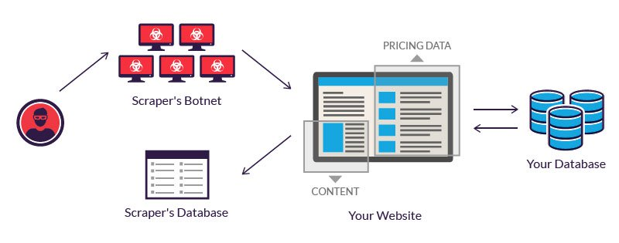
LSTM
GAN
Auto encoders

Slide 9
EXISTING SYSTEMS
Summarize Bot
This AI and blockchain-powered tool allows users to know more by reading less with summarization of long texts.
Text Summarization
This online platform provides summarization of web pages in a simple and straightforward format
PICTORY.AI
Automatically create short, highly-sharable branded videos from your long form content.

Slide 10
EXISTING METHODOLOGY
There are some existing systems like which I have show above in which the are implementing the summarization using python libraries and deep learning techniques.
In video summarization they will convert into audio using some python libraries and deep learning concepts and then they will extract then audio and convert into text summary.
Text rank algorithm is used for summarization
Text to text summarization they use NLP techniques.

Slide 11
PROPOSED METHODOLOGY
Here we are creating a web application
with 5 main modules.
Text to text summarization
Video to text summarization
Audio to text summarization
Video to video summarization
Audio to audio summarization

Slide 12
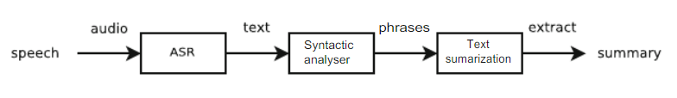
Audio to text summarization

Slide 13
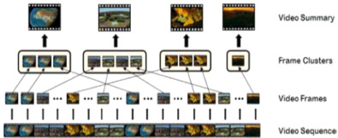
Video to video summarization
Video summarization aims to provide an automated way of generating short and informative versions of the original video by identifying the most important and relevant content.
In this section, the steps in video Summarization and the architecture of the proposed model are shown in figures respectively.

Slide 14
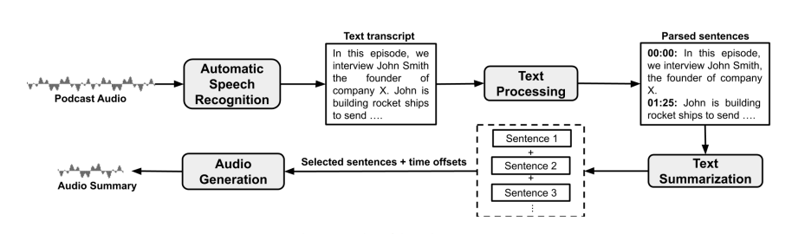
Audio to Audio summarization

Slide 15
LITERATURE REVIEW ON AUTOMATIC SUMMARIZATION
Author has analyzed and compared the performance of three different algorithms. Firstly, the different text summarization techniques explained. Extraction based techniques are used to extract important keywords to be included in the summary. For comparison three comparison three keyword extraction algorithms namely TextRank, LexRank, Latent Semantic Analysis (LSA) were used. Three algorithms are explained and implemented in python language. The ROUGE 1 is used to evaluate the effectiveness of the extracted keywords. The results of the algorithms compared with the handwritten summaries and evaluate the performance. In the end, the TextRank Algorithm gives a better result than other two algorithms.

Slide 16
References:
Video Summarization Using Deep Neural Networks: A Survey by Evlampios Apostolidis , Eleni Adamantidou , Alexandros I. Metsai , Vasileios Mezaris , Senior Member, IEEE, and Ioannis Patras , Senior Member, IEEE
Video Transcription and Summarization using NLP By KhushiPorwal, Harshit Srivastava, Ritik Gupta , ShiveshPratap Mall, Nidhi Gupta
Text Summarization Techniques: A Brief Survey Mehdi Allahyari ,Seyedamin Pouriyeh , Saeid Safaei , Mehdi Assef, Elizabeth D. Trippe, Juan B. Gutierrez, Krys Kochut
Automatic Speech Summarisation: A Scoping Review By Dana Rezazadegan1,2,*, Shlomo Berkovsky2 , Juan C. Quiroz3,2, A. Baki Kocaballi4,2, Ying Wang2 , Liliana Laranjo5,2, Enrico Coiera2
Text Summarization:An Overview
PodSumm: Podcast Audio Summarization ANEESH VARTAKAVI∗ and AMANMEET GARG∗ , Gracenote Inc
Robust video summarization algorithm using supervised machine learning
Author links open overlay panelSunil SHarakannanavarªShaik RoshanSameerªVikashKumarªSunil KumarBeheraªAdithyaV AmberkarªVeena I.Puranikmath^{b}
Robust video summarization algorithm using supervised machine learning
Author links open overlay panelSunil SHarakannanavarªShaik RoshanSameerªVikashKumarªSunil KumarBeheraªAdithyaV AmberkarªVeena I.Puranikmath^{b}

Slide 17
THANK YOU

Slide 18
XICONCLSUINING METHODOLOGY

